Slide 1
Introduction to I2C Communication Protocol

Slide 2
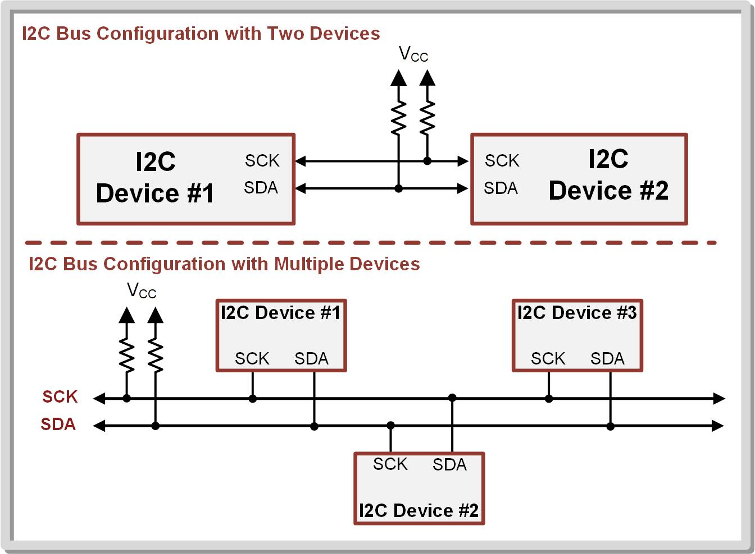
I2C Protocol
The Inter-Integrated Circuit (I2C) standard is a serial interface implement with a two-wire link that can support multiple masters and multiple slaves.
An I2C link is always half-duplex, meaning that all devices share the data line with only one device transmitting at any given time.
Providing a clock allows higher data rates over UART.
The two-wire interface allows devices to be added without increasing the number of lines like on SPI.

Slide 3
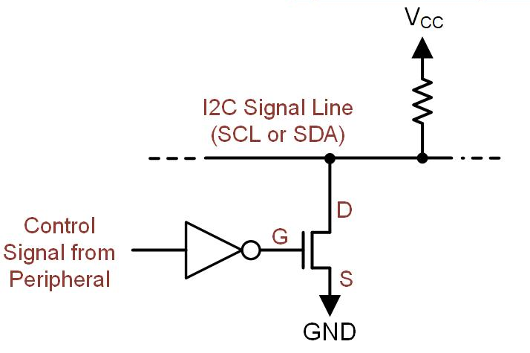
Why Pull up resistors
Open-drain output stage – supports multiple drivers on the same signal line using NMOS transistor.
Driving a LOW to the NMOS yields a HIGH on the line. - Driving a HIGH on the NMOS yields a LOW on the line.
To get back to positive logic, we insert an inverter before the NMOS
High(1)
High(1)
OFF
Low

Slide 4
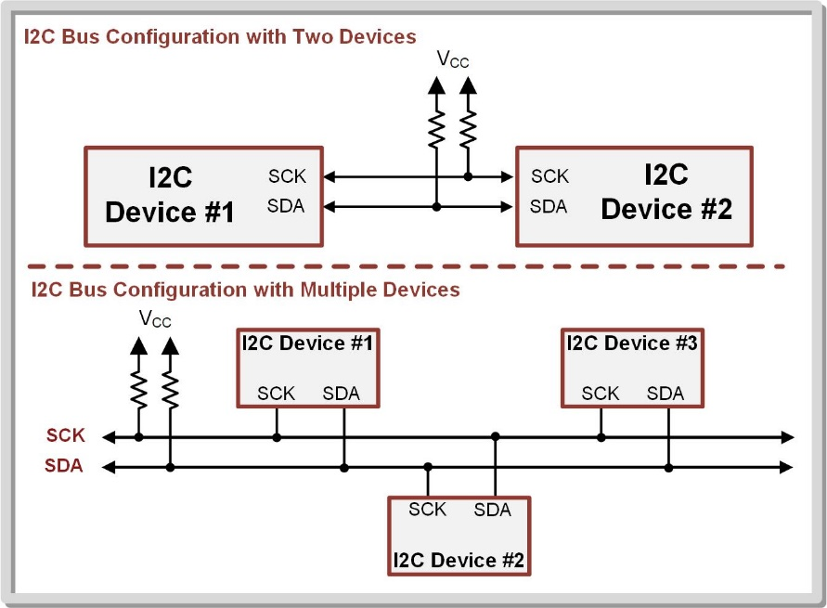
An I2C bus ALWAYS needs external pull-up resistors on each of its lines.
These can’t be implemented on the MCU because the resistor function is only available when the port is configured as an INPUT.
Since I2C is bidirectional, we never know wither the pin will be an input or output.

Slide 5
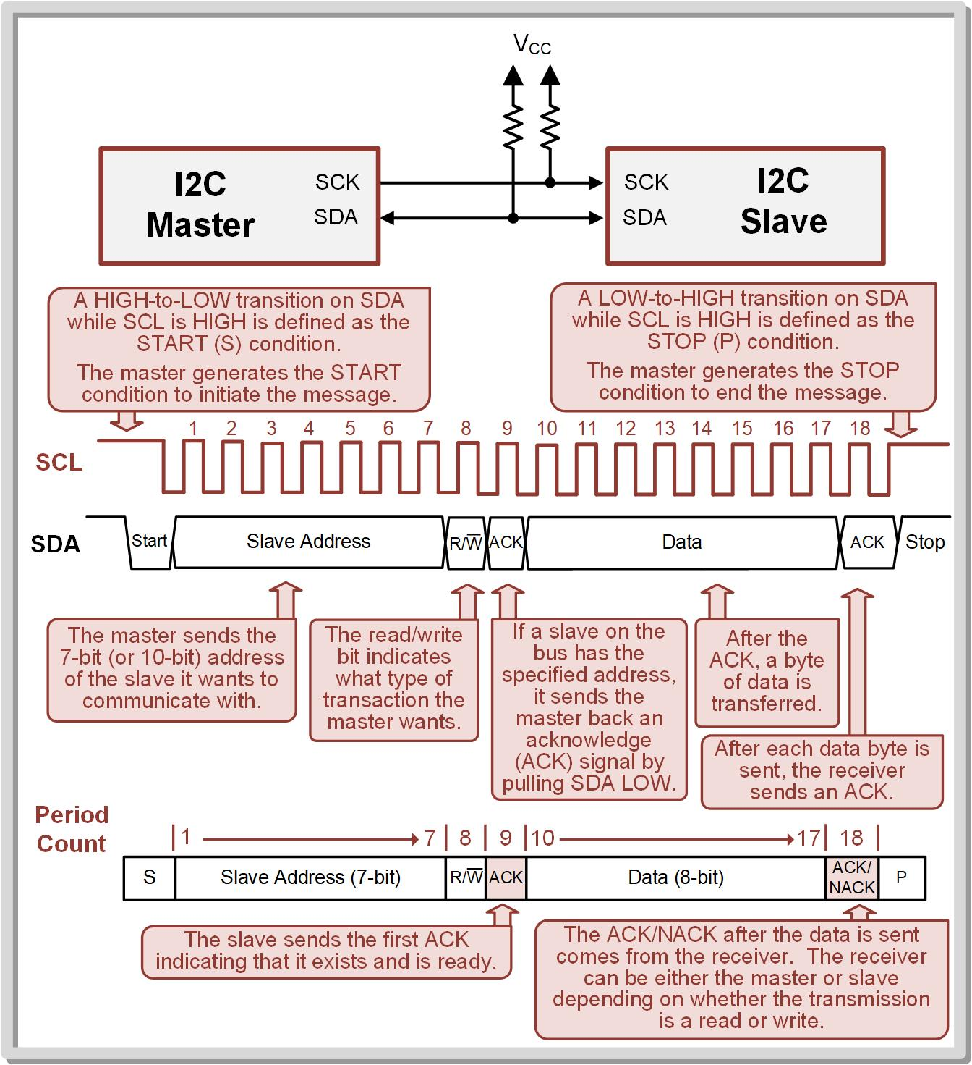
Basic Packet Structure
Master – the device that initiates communication and controls the clock.
Multiple masters are also supported on an I2C bus.
Slave – a device on the bus that is read or written to, but does not initiate transmission or provide a clock.
Slave address – a unique and predetermined address for each slave on the bus.
This address is used by the master to indicate which slave it wants to communicate with.

Slide 6
Idle – when both SDA and SCL are held high by the pull-up resistors and no I2C device is attempting to communicate.
Busy – when devices are driving the bus.
Messages – how I2C information is transferred.
A master initiates a new message by generating a START (S) condition by pulling SDA LOW while SCL is still HIGH.
As soon as the START condition is generated, the SCL will be pulled LOW and start pulsing to provide the clock for the message.
The master is responsible for pulsing the clock

Slide 7
Each clock pulse within the I2C message is numbered by periods.
After the master generates the START condition, it first sends the slave address that it wishes to communicate with.
I2C slave addresses can either be 7-bit (default) or 10-bit.
The slave address is followed by the read/write signal indicating which type of transaction is being requested in the message.
The START condition, slave address, and read/write signal constitute periods 1 → 8.
Period 9 of the message is reserved for the slave acknowledge (ACK) or no-acknowledge (NACK) signal.
After the slave address and read/write signal are sent by the master, each slave on the bus checks whether it is being addressed.
If a slave exists with the specified slave address, it will send an ACK signal back to the master by pulling SDA LOW.
If no device exists with the specified slave address, no device will pull down SDA. This will result in period 9 remaining HIGH and will be interpreted as a NACK.

Slide 8
If the master sees the ACK signal, it knows a slave exists with the specified address and proceeds with the message.
After each byte is sent, the receiving device sends an ACK signal indicating that it successfully received the data.
A STOP condition occurs when there is a LOW-to-HIGH transition on SDA while SCL is HIGH.
Once, SDA goes HIGH, SCL also remains HIGH indicating that the bus is idle again.

Slide 9
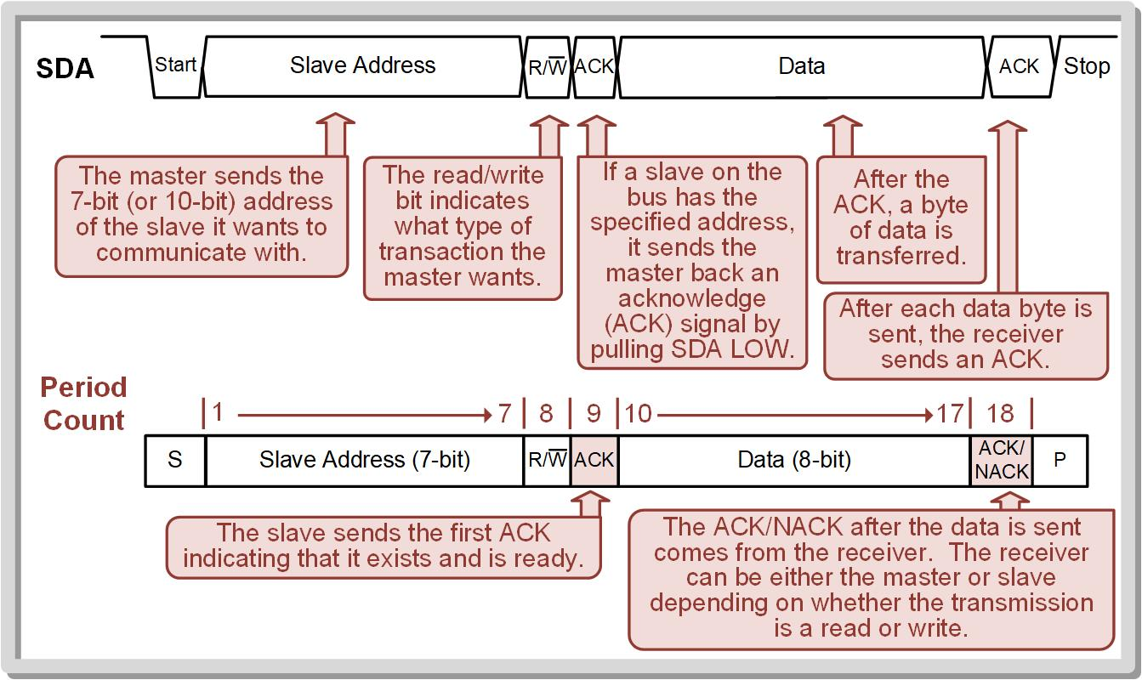

Slide 10
When the master is writing to a slave, the master sends the 8-bits of data and the slave produces the ACK/NACK signal.
When the master is reading from a slave, the slave sends the 8-bits of data and the master produces the ACK/NACK signal.
After the data has been sent and acknowledged, the master can end the message by generating the STOP condition anytime.
The Master can send multiple data bytes in a single message.

Slide 11
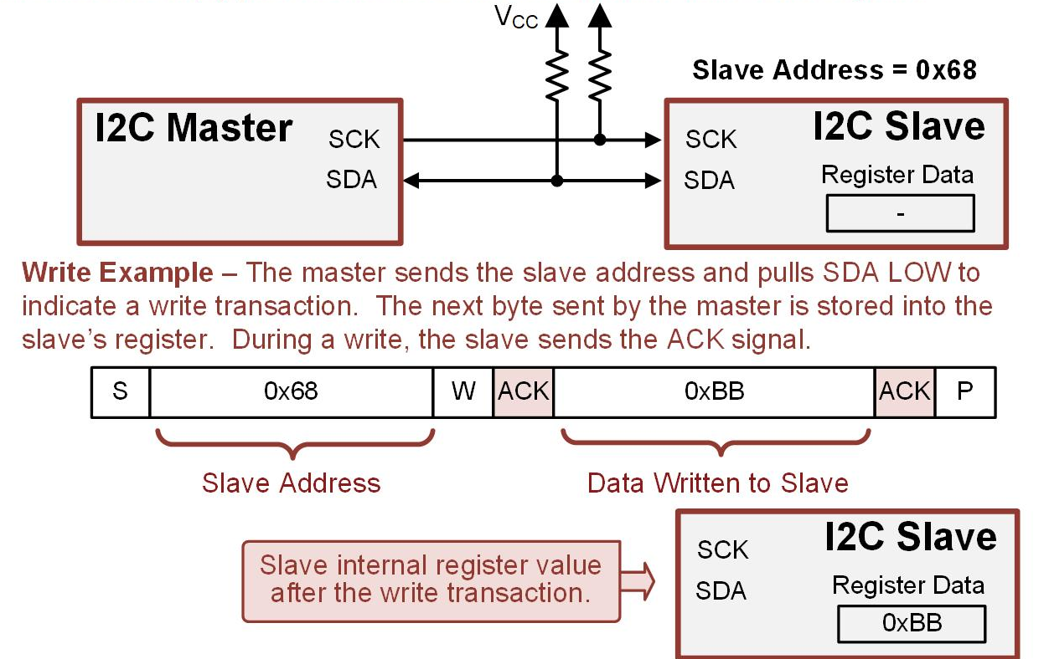
Slave Registers
I2C devices contain individual registers that hold their information.
In the simplest case, an I2C device contains only a single register.
Writing to a slave with a single register.
The master initiates the message by sending the S bit.
The master provides the slave address and a WRITE signal.
The slave ACKs to indicate it is ready.
The master writes the data.
The slave sends an ACK that it got the data.
The master ends the message by sending the P bit.
No register address is needed.

Slide 12
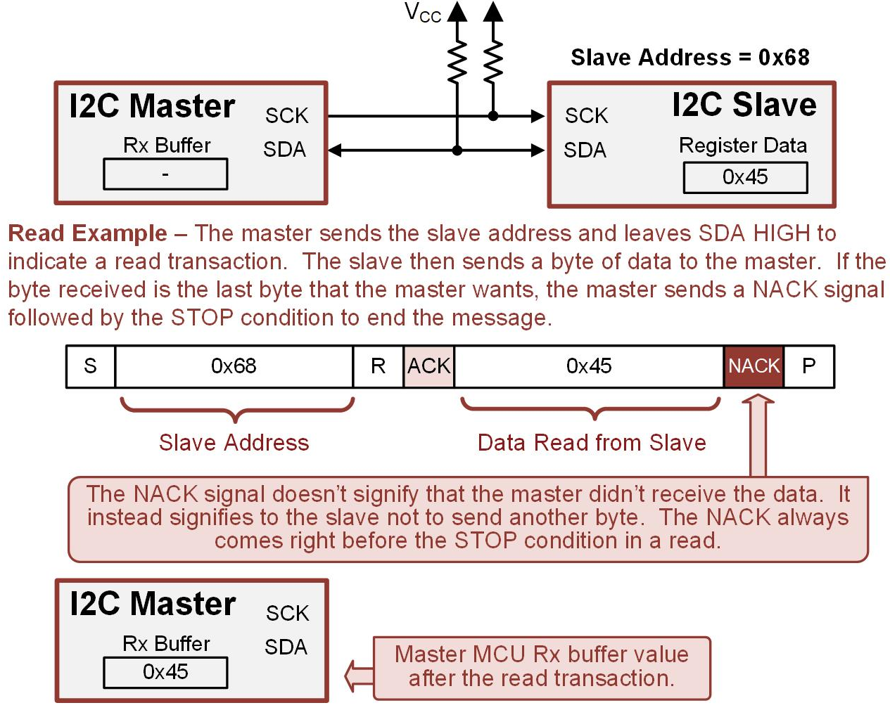
No register address is needed.
Reading from a slave with a single register.
The master initiates the message by sending the S bit.
The master provides the slave address and a WRITE signal.
The slave ACKs to indicate it is ready.
The slave sends the data.
The master sends a NACK to stop the slave from sending more data.
The master ends the message by sending the P bit.

Slide 13
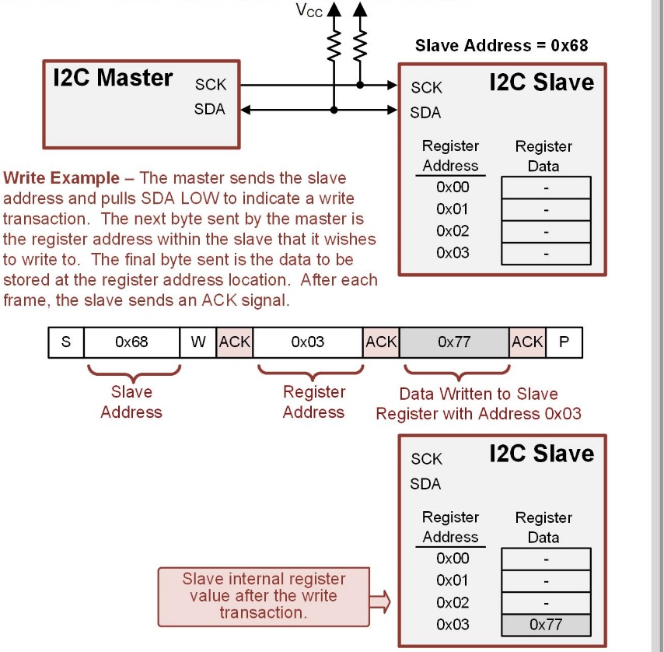
When an I2C device has multiple registers, each is assigned a register address.
To access a specific register in the slave, the master needs to provide the register address in the message.
For a write transaction, the master generates an I2C message that first provides the slave address, then provides the register address to access, then provides the data to be written.
After each frame, the slave sends an ACK signal.

Slide 14
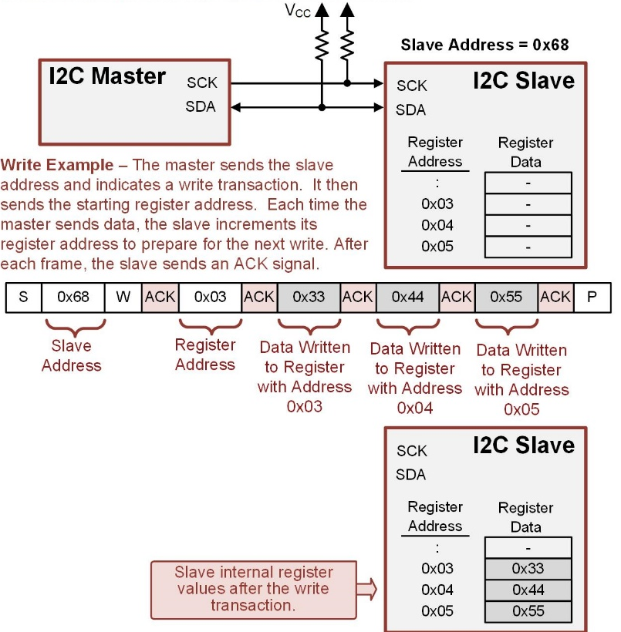
Check the slave’s datasheet for details!!!
The master can also write a block of data to registers.
The slave automatically increments the starting address after each byte of data is written.
The master still sends the slave address, the write signal, and the starting register address.
The next byte of data that is sent goes into the first register address location.
The slave will continue to increment its register address until it sees the STOP condition generated by the master.

Slide 15
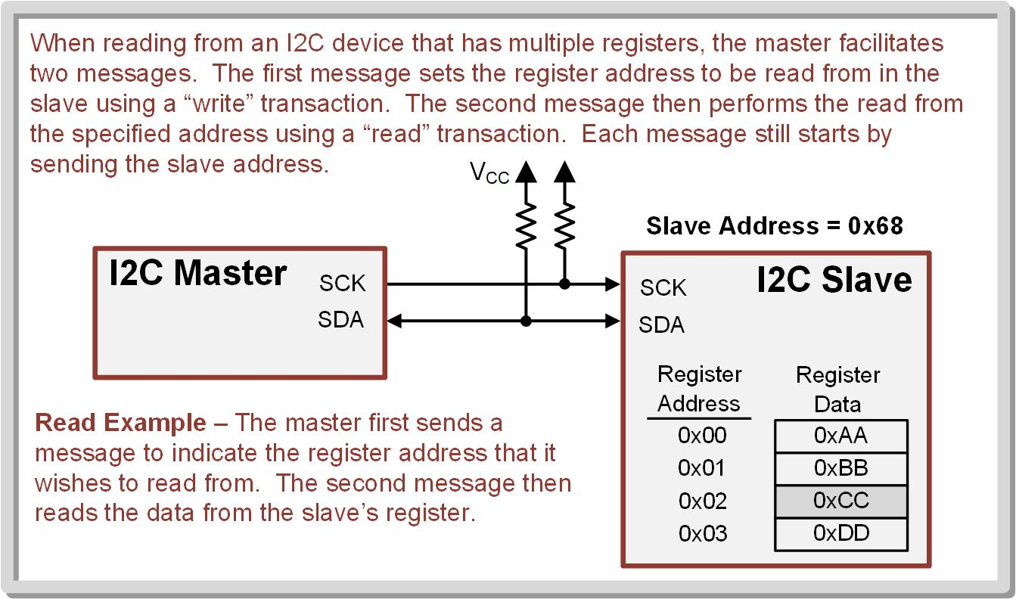
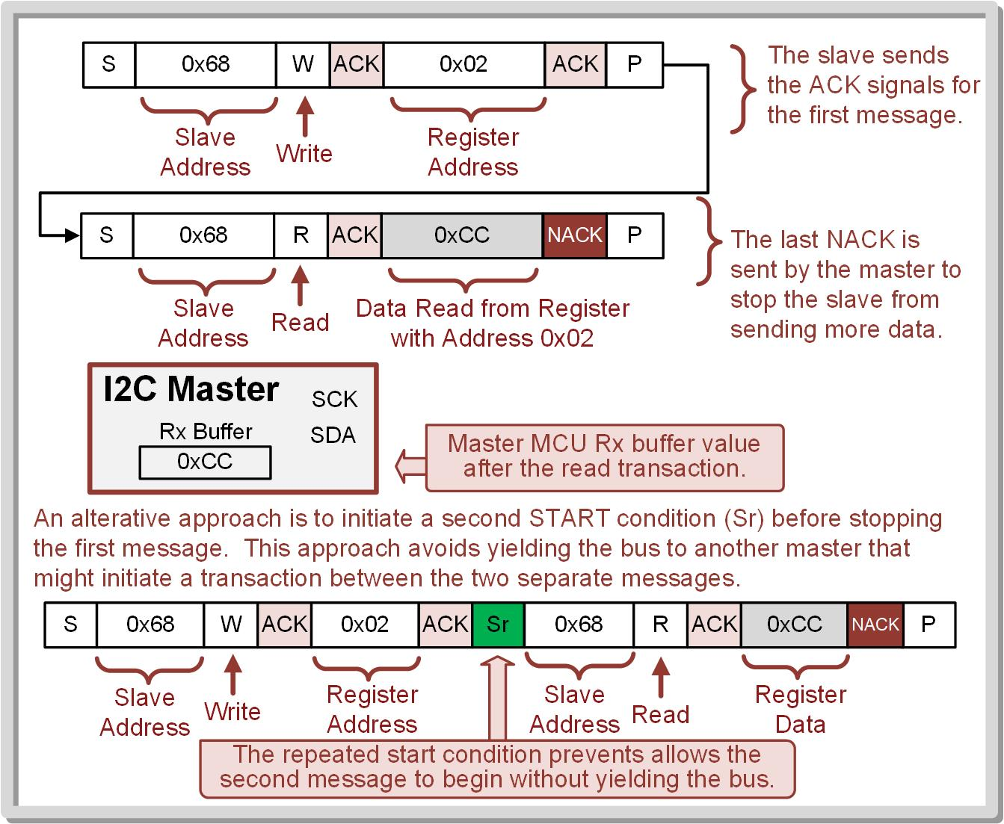
Reading data
When reading from a device that contains multiple registers, two message are needed.
The first message sets the register address within the slave that will be read from using a write transaction.
The first message puts the slave into a mode where it’s expecting a second message that will read data from the register address that was just sent.
The second message performs a read transaction that retrieves the data from the register address sent in the first message.

Slide 16
EUSCI_Bx | PIN | I2C | P1SEL1:0 to select eUSCI
EUSCI_B0 | P1.6 | SDA | P1SEL1.6=0 P1SEL0.6=1
 | P1.7 | SCK | P1SEL1.7=0 P1SEL0.7=1
EUSCI_B1 | P6.4 | SDA | P6SEL1.4=0 P6SEL0.4=1
 | P6.5 | SCK | P6SEL1.5=0 P6SEL0.5=1
EUSCI_B2 | P3.6 | SDA | P3SEL1.6=0 P3SEL0.6=1
 | P3.7 | SCK | P3SEL1.7=0 P3SEL0.7=1
EUSCI_B3 | P10.2 | SDA | P10SEL1.2=0 P10SEL0.2=1
 | P10.3 | SCK | P10SEL1.3=0 P10SEL0.3=1
The MSP432P401R contains four eUSCIs that support I2C – eUSCI_B0, eUSCI_B1, eUSCI_B2 and eUSCI_B3.
These four eUSCI peripherals are configurable to either support I2C or SPI.
The PxSEL1: PxSEL0 registers are used to select which serial peripheral drives the pins on the MSP432P401R MCU.

Slide 17
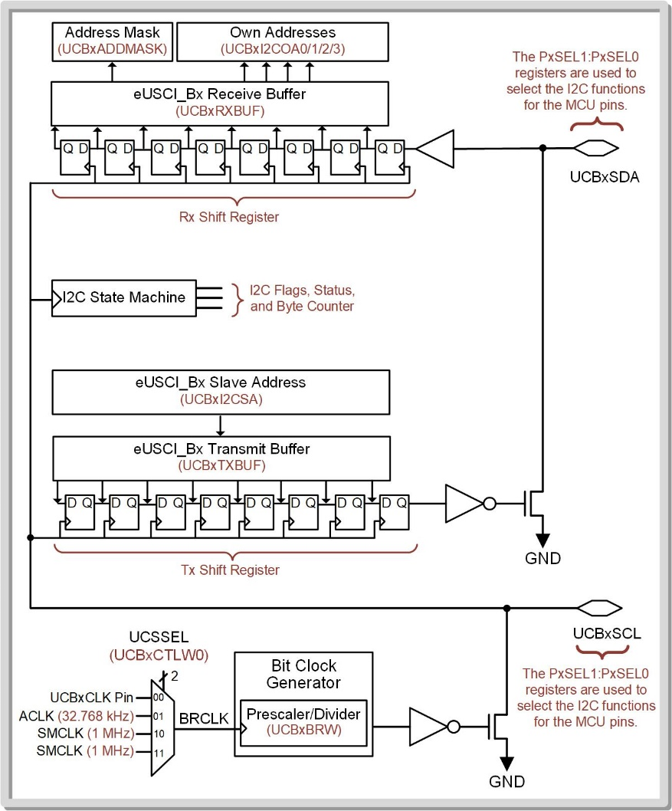
I2C Configuration
The I2C system contains a variety of configuration registers that are used to trigger events, indicate when certain conditions have occurred, and hold various information such as the slave address and the data sent or received.

Slide 18
Configuration registers for I2C
eUSCI_Bx Control Word 0 (UCBxCTLW0) – has different bit fields when in I2C mode.
eUSCI_Bx Control Word 1 (UCBxCTLW0) – has different bit fields when in I2C mode.
eUSCI_Bx Bit Rate Control Word (UCBxBRW) – same function as in SPI mode.
eUSCI_Bx Status (UCBxSTATW) – has different bit fields when in I2C mode.
eUSCI_Bx Byte Counter Threshold (UCBxTBCNT)
eUSCI_Bx Receive Buffer (UCBxRXBUF) – same function as in SPI mode.
eUSCI_Bx Transmit Buffer (UCBxTXBUF) – same function as in SPI mode.
eUSCI_Bx I2C Own Address 0 (UCBxI2COA0)
eUSCI_Bx I2C Own Address 1 (UCBxI2COA1)
eUSCI_Bx I2C Own Address 2 (UCBxI2COA2)
eUSCI_Bx I2C Own Address 3 (UCBxI2COA3)
eUSCI_Bx Received Address (UCBxADDRX)
eUSCI_Bx Address Mask (UCBxADDMASK)
eUSCI_Bx I2C Slave Address (UCBxI2CSA)
eUSCI_Bx Interrupt Enable (UCBxIE) – has different bit fields when in I2C mode.
eUSCI_Bx Interrupt Flag (UCBxIFG) – has different bit fields when in I2C mode.
eUSCI_Bx Interrupt Vector (UCBxIV) – has different bit fields when in I2C mode.

Slide 19
I2C Master Operation
Step 1: Set the UCSWRST bit in the UCBxCTLW0 configuration register to put the eUSCI_Bx peripheral into software reset.
Step 2: Initialize all the eUSCI_Bx configuration registers.
Step 3: Configure ports.
Step 4: Clear UCSWRST – takes the eUSCI_Bx out of reset.
Step 5: Enable interrupts (optional) in the UCBxIE configuration register.

Slide 20
The clock setup is the same as SPI.
UCSSEL chooses between an external pin, ACLK, or SMCLK.
The UCBxBRW register holds the prescalar value used to divide down the clock.
The slave address is stored in the UCBxI2CSA register.
This value is automatically shifted out first after a Start bit.
The R/W! signal is configured in UCBxCTLW0.
It is automatically sent out after the slave address.

Slide 21
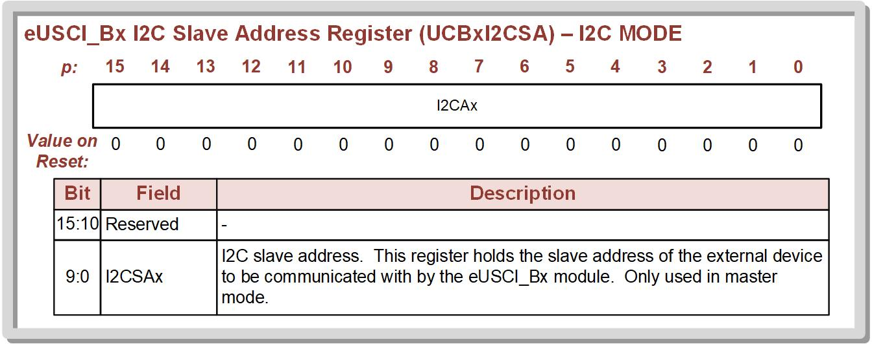
Writing data as a slave

Slide 22
The I2C state machine watches for the slave address ACK signal before proceeding.
Data is then either written or read.
To write, data is stored in the Tx Buffer prior to triggering the message Start bit.
To read, data is available in the Rx buffer after it arrives.
A “Byte Counter” is used to control how many bytes of data will be read or written in a message.
The byte counter is held in register UCBxTBCNT.

Slide 23
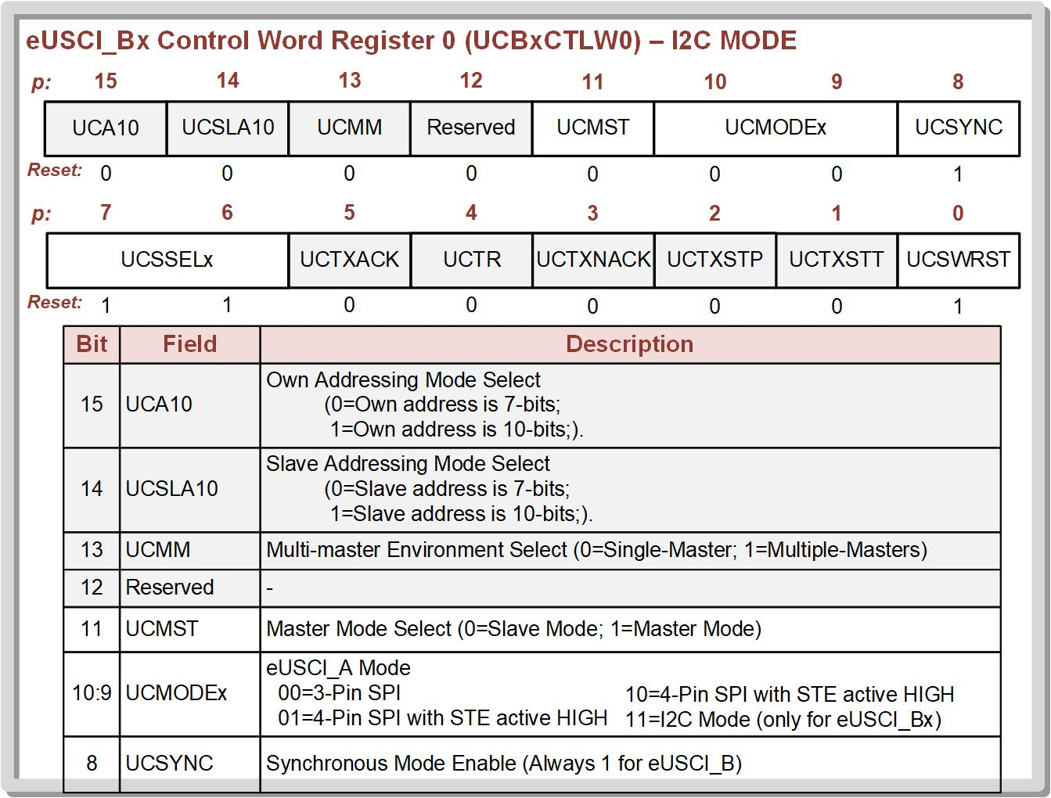
Control Word Register 0
Needed for
Minimal Setup

Slide 24
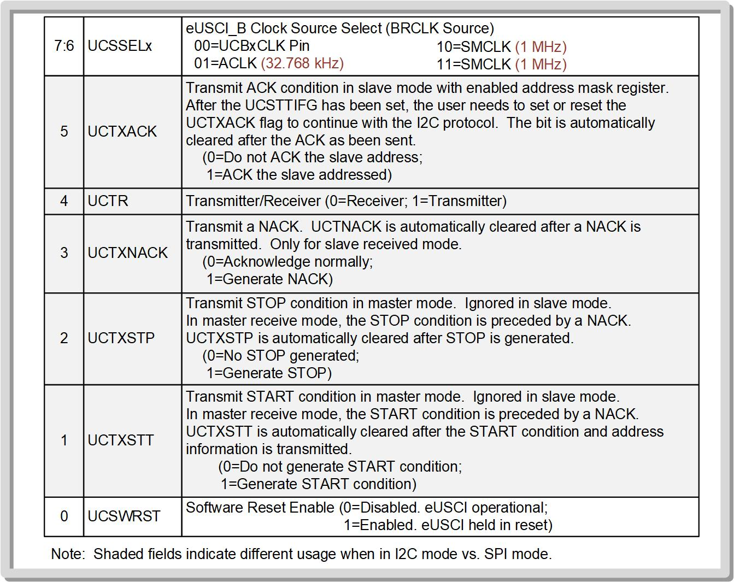
Needed for
Minimal Setup
This is how message
is started

Slide 25
The next step to set up the clock is configuring the UCBxBRW register, which is the prescaler/divider for the source clock.
The value that is stored into UCBxBRW will divide the incoming clock source to produce the SCL that will be used by the master and all slaves.
This register is used in the same way for the I2C as in SPI as a clock prescaler/divider.
The UCMODEx bits dictate whether the peripheral is set up in SPI or I2C (UCMODEx = 11 for I2C).
Since only SPI and I2C are used in the eUSCI_Bx peripherals, the synchronous mode enable (UCSYNC) bit is always high.
The UCMST bit in UCBxCTLW0 dictates whether the MCU will be the I2C master (UCMST = 1) or slave (UCMST = 0).

Slide 26
The UCTR bit dictates whether the MCU will be transmitting (UCTR = 1) or receiving (UCTR = 0) data.
The UCA10 bit configures whether the MCUs own slave address is 7-bits or 10-bits when the MCU is the slave.
The UCA10SLA bit configures whether the external slave address is 7-bits or 10-bits when the MCU is the master.
There are also four bits within UCBxCLTW0 that will trigger events on the I2C bus such as generating a START condition (UCTXSTT = 1), generating a STOP condition (UCTXSTP = 1), sending an ACK (UCTXACK = 1), and sending a NACK (UCTXNACK = 1).

Slide 27
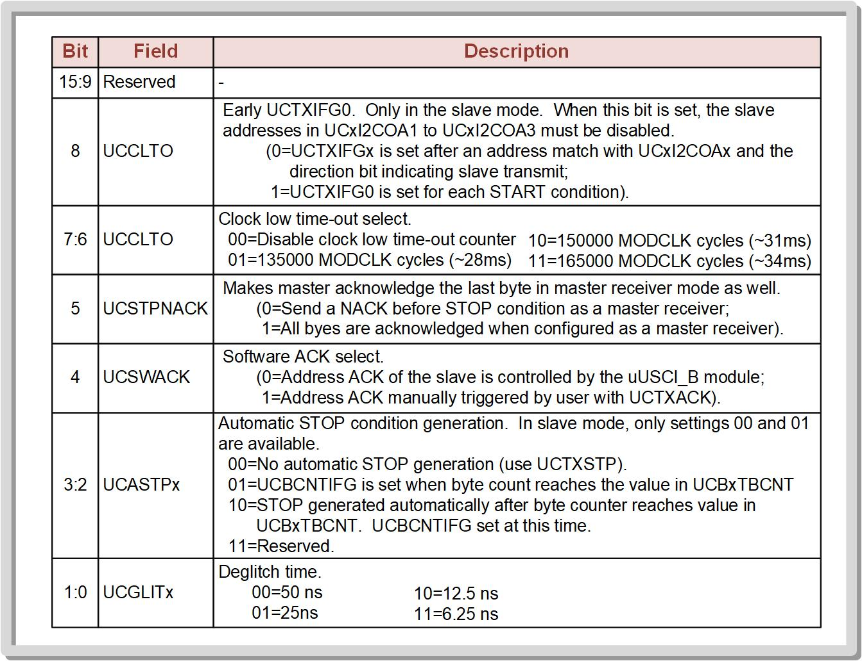
Control Word 1
The easiest mode of operation is to use the Byte Counter and Automatic STOP.

Slide 28
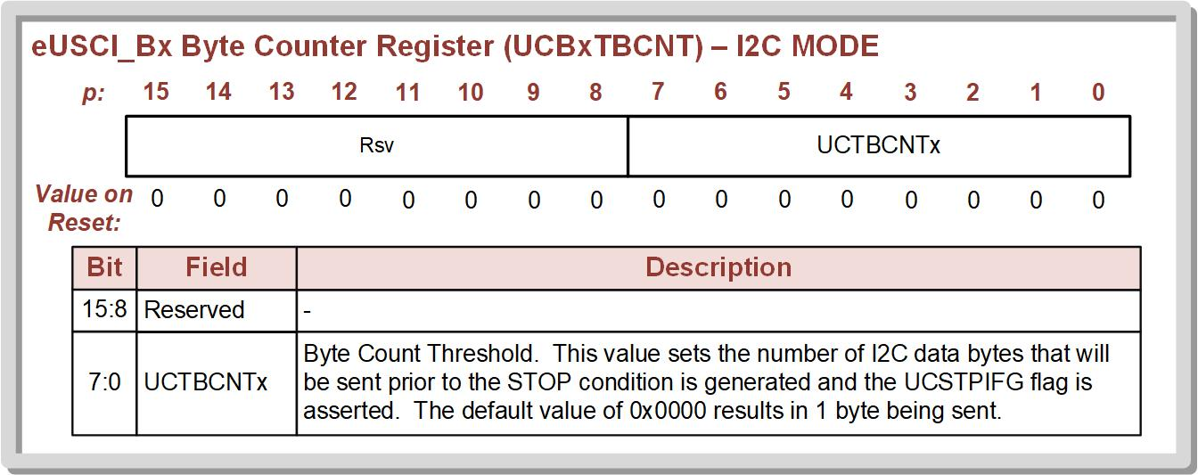
The most commonly used setting is the automatic STOP condition generation (UCASTPx).
When UCASTPx = 10, the master will automatically generate the STOP condition once the desired number of data bytes have been sent or received.
The last configuration needed to set up a basic master write transmission is the number of bytes that are to be sent using the UCBxTBCNT register.
The MCU will continue to send until the number of bytes transferred matches the value in UCBxTBCNT.
After the desired number of bytes has been transferred, the master will automatically generate the STOP condition if UCASTPx = 10.

Slide 29
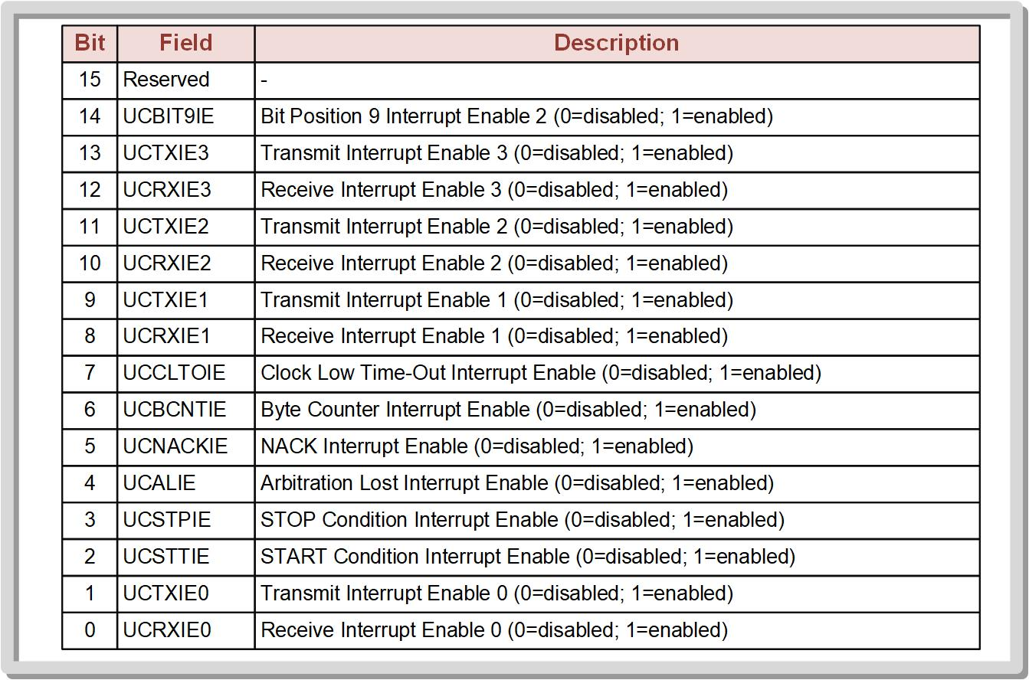

Slide 30
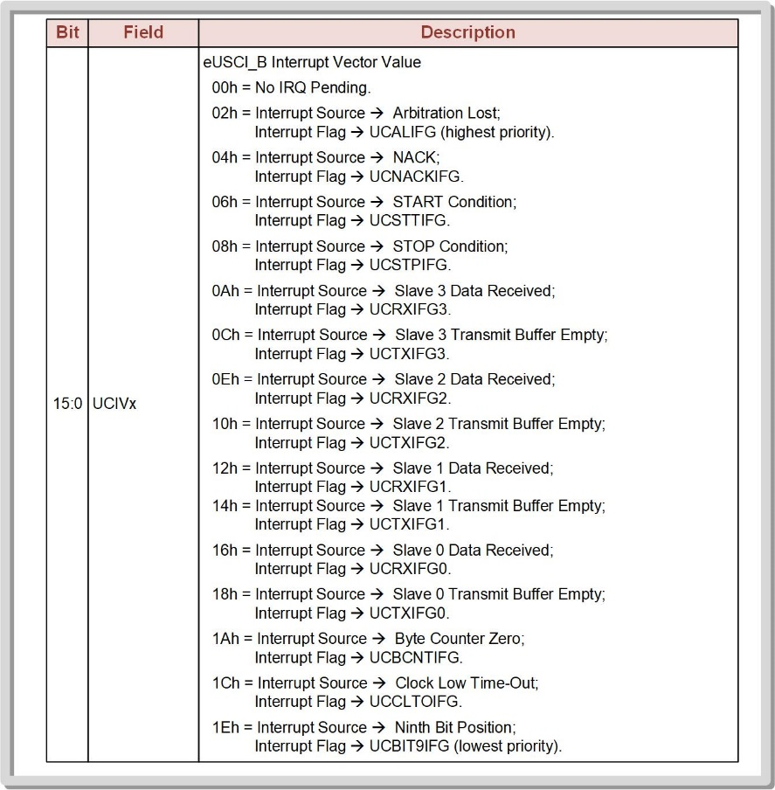
eUSCI_Bx Interrupt Vector Table

Slide 31
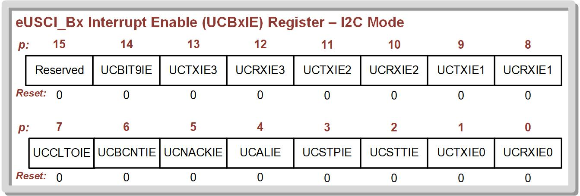
UCTXIE0: After a message is Started (S), this interrupt will fire when data is ready to go into the Tx buffer.
This is used for WRITE messages.
UCRXIE0: After a message is Started (S), this interrupt will fire when data is ready to be ready from the Rx buffer.
This is used for READ messages.

Slide 32
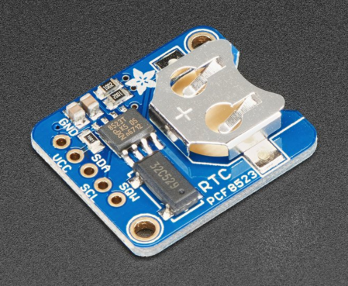
Adafruit PFC8523 I2C Slave
To begin programming the I2C peripheral on the MSP430FR2355, we need a slave that can acknowledge packets and transmit data back and forth.
We will use the PFC8523 RTC device. This is a simple I2C slave with 20x registers that can be read or written to.
The IC on this board is the NXT PCF8523 RTC + calendar (this is the datasheet we need).

Slide 33
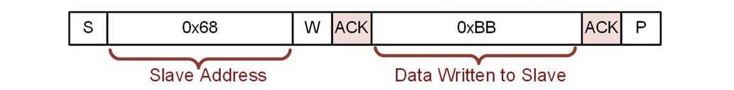
Writing one byte of data to I2C Slave
Let's configure the eUSCI_B0 peripheral as an I2C master and continually transmit the value of 0x88. The receiving slave device in this example is the Adafruit PCF8523 Real Time Clock with a hardcoded slae address of 0x68. This is the I2C message we are trying to create:
0x88

Slide 34
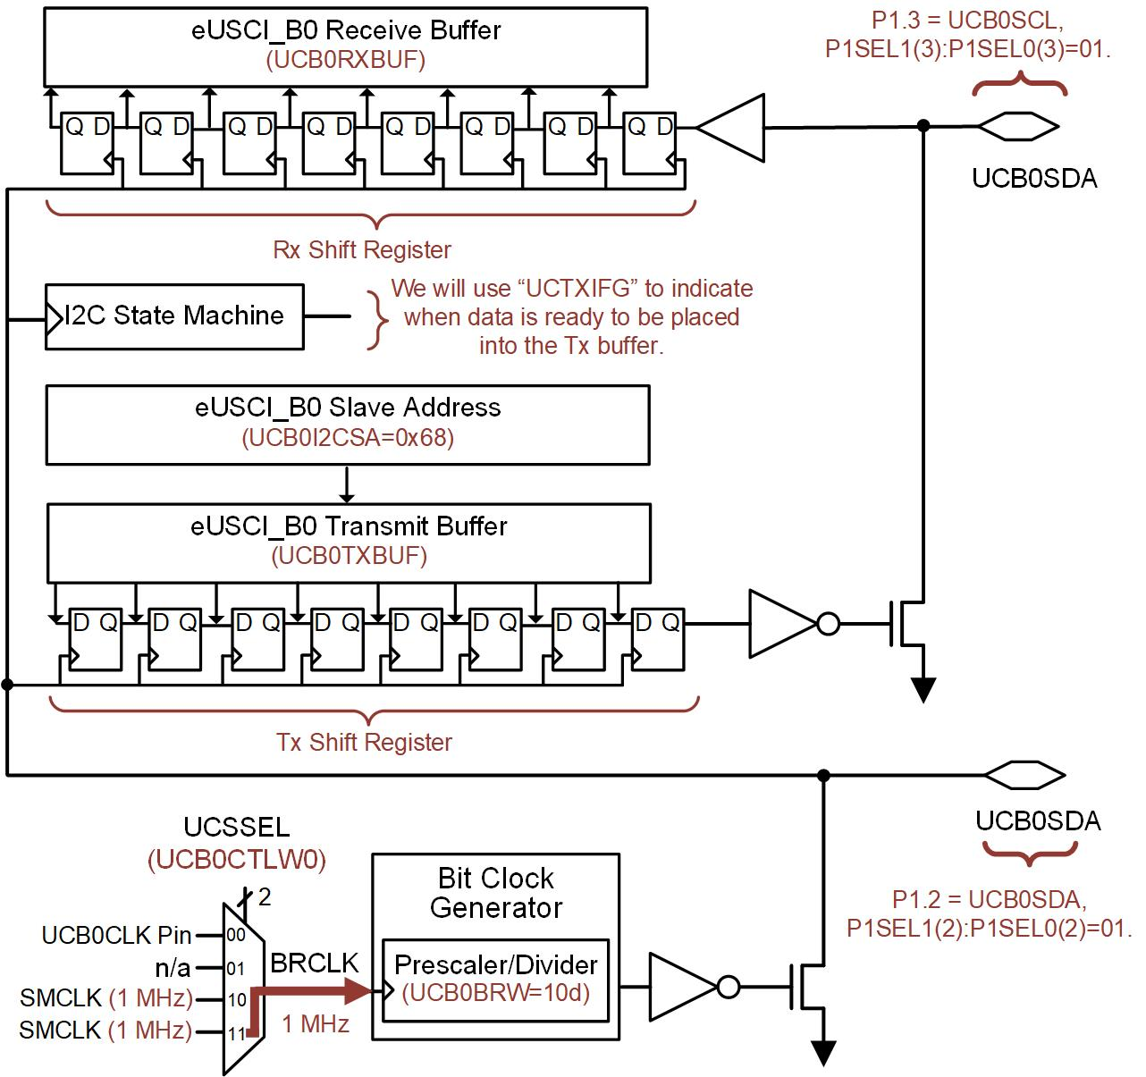
7
7
7
Next, we setup the I2C system:
UCMODE = I2C mode
UCMST = Master
UCTR = Transmit = Write
I2CSA = Slave Address = 0x68
Next, setup clock. We’ll choose SMCLK and divide by 60 to get SCK=100kHz.
6
6
6
6

Slide 35
Then we setup how we’ll handle data transmission and the STOP bit.
We’ll use the Byte Counter (UCB0TBCNT) to dictate how many bytes are written.
We’ll use UCASTP=10b to automatically generate a STOP when the number of bytes in UCB0TBCNT have been sent.
7
7
7
We need to use the Port Function Select (P1SEL1:P1SEL0) registers to use I2C instead of the ports.
6
6
6
6
6
6
6

Slide 36
7
Now for triggering the message:
We’ll start a message by manually setting the UCTXSTT bit in the main loop.
We’ll use a delay loop to space out the message starts.
We’ll use a TXIFG interrupt to put data into the Tx Buffer when the message is ready (i.e., when a slave as ACK’d its slave address).
7
7
- We’ll need to enable UCTXIE0 and write an ISR to store data to the Tx Buffer.
- The vector is: EUSCI_B0_VECTOR
6
6
6
6
6

Slide 37
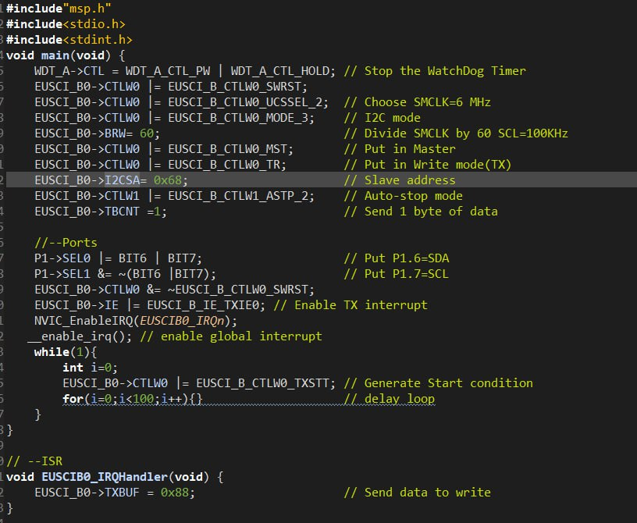

Slide 38
To View the output
Connect the Adafruit PCF8523 Real Time Clock to the eUSCI_B0 I2C pins on the board. You will also need to provide +5V and GND to the slave. All signals can be accessed on the J1 header of the board.
Probe SCL and SDA with a logic analyzer. Configure the logic analyzer to interpret the data as an I2C bus and trigger on the START condition.

Slide 39
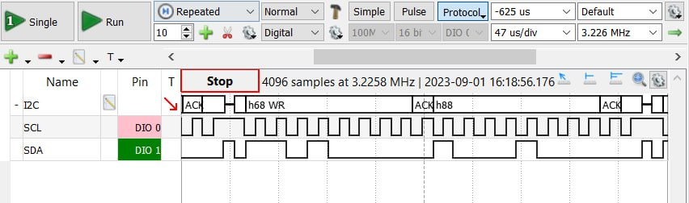
Output
Start bit
Slave address and Write
Slave Acks after writing each byte
Slave Ack'd
Master Write 0x88

Slide 40
Reading one byte of data
The only difference during eUSCI_B0 initialization for reading is to put the peripheral into receive mode using UCTR = 0.
The UCRXIFG0 will be asserted when the slave sends back a byte of data and it arrives in the Rx buffer.
This flag will trigger an eUSCI_B0 interrupt.
The Rx buffer value will be stored in a variable.
The master will produce a NACK signal after the last byte in the transmission has been received as dictated by the value in UC0TBCNT.

Slide 41
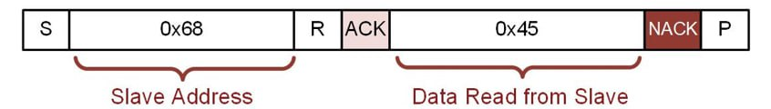
Reading one byte of data
Let’s configure the eUSCI_B0 peripheral as an I2C master and continually read a single byte from a slave. The transmitting slave device in this example is the Adafruit PCF8523 Real Time Clock with a hardcoded slave address of 0x68.
This value could be anything as we are
Reading from Seconds register of Adafruit

Slide 42
7
7
7
First, put into SW Reset using the UCSWRST Bit in UCB0CTLW0.
Next we setup the I2C system:
UCMODE = I2C mode
UCMST = Master
UCTR = Receive = Read
I2CSA = Slave Address = 0x68
Next, setup clock. We’ll choose SMCLK and divide by 60 to get SCL=100kHz.
6
6
6
6
6
6
6

Slide 43
7
7
7
Then we setup how we’ll handle data transmission and the STOP bit.
We’ll use the Byte Counter (UCB0TBCNT) to dictate how many bytes are read.
We’ll use UCASTP=10b to automatically generate a STOP when the number of bytes in UCB0TBCNT have been received.
We need to use the Port Function Select (P1SEL1:P1SEL0) registers to use I2C instead of the ports.
Next, take B0 out of SW Reset using the UCSWRST Bit in UCB0CTLW0.
6
6
6
6

Slide 44
7
7
7
Now for triggering the message:
We’ll start a message by manually setting the UCTXSTT bit in the main loop.
We’ll use a delay loop to space out the message starts.
We’ll use a RXIFG interrupt to read data out of the Rx Buffer after it arrives.
- We’ll need to enable UCRXIE0 and write an ISR to read the Rx buffer.
- The vector is: EUSCI_B0_VECTOR
6
6
6
6
6
6
6

Slide 45
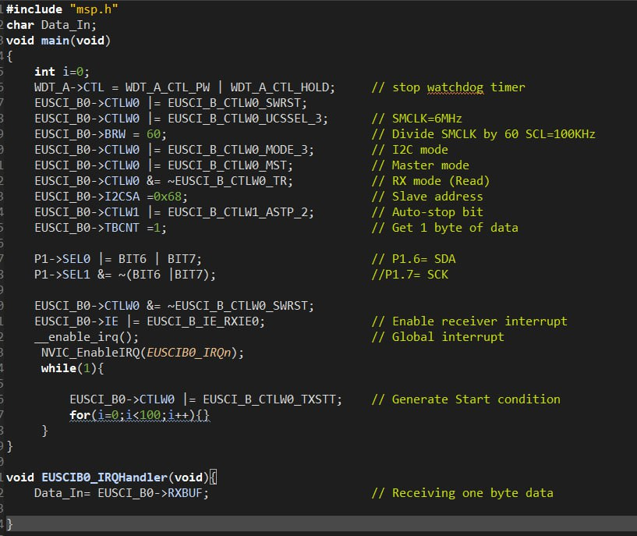

Slide 46
To View the output
Connect the Adafruit PCF8523 Real Time Clock to the eUSCI_B0 I2C pins on the board. You will also need to provide +5V and GND to the slave. All signals can be accessed on the J1 header of the board.
Probe SCL and SDA with a logic analyzer. Configure the logic analyzer to interpret the data as an I2C bus and trigger on the START condition.

Slide 47
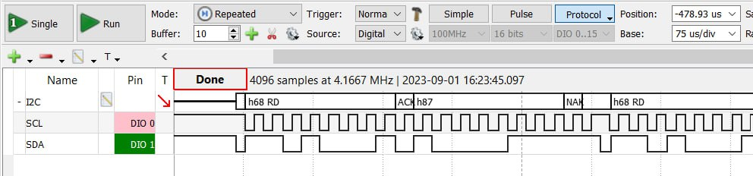
Output
Start bit
Master Acks NACK after reading each byte
Slave address and Read
Slave Ackd
Master Reads 0x87

Slide 48
Slave operation of MSP432P401R
While most of the time an MCU acts as the I2C master, the MSP432P401R also can be configured as an I2C slave.
Use UCMODx = 11 puts the peripheral into I2C mode.
Use UCMST = 0 configures the peripheral as a slave.

Slide 49
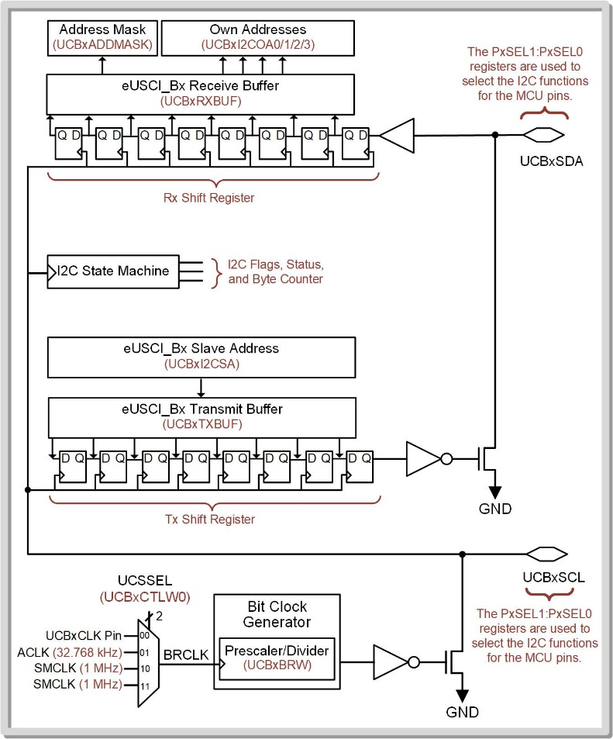
In slave mode, the MCU doesn’t produce SCL, so no configuration of UCSSELx or UCBRx is needed.
The MSP432 supports up to four separate and user-programmable slave addresses.
The slave address values are stored in the eUSCI_Bx I2C Own Address n (UCBxI2COAn) registers by the user during initialization.

Slide 50
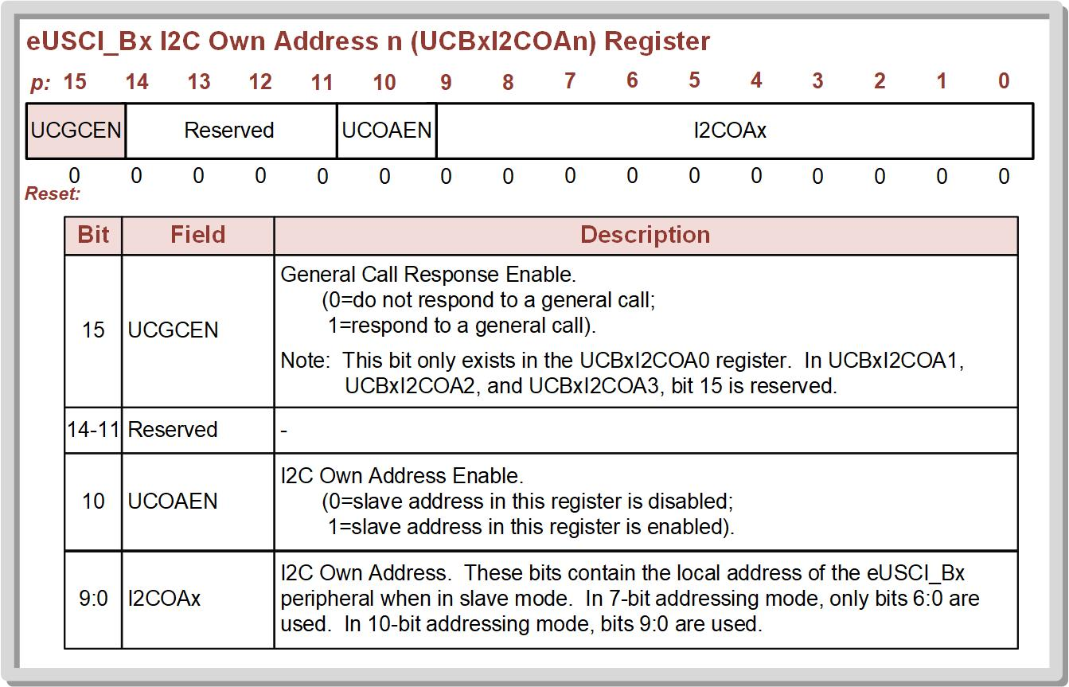
The four specific register names in the MSP432 are UCBxI2COA3, UCBxI2COA2, UCBxI2COA1, UCBxI2COA0.
The MCU is first put into receiver mode using UCTR = 0 in order to receive the I2C slave address that the master sends out to all slaves.
Each register contains an Own Address Enable (UCOAEN) bit in position 10 that must be asserted if the slave address is to be active.

Slide 51
The UCBxI2CA0 register is unique in that its 15th position is the General Call Response Enable (ECGEN) for the MCU’s entire slave system.
The 15th position in the other three I2C own address registers are reserved.

Slide 52
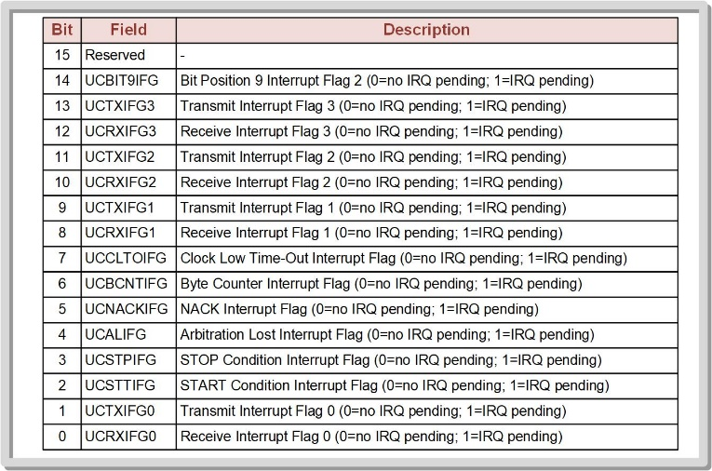
6
6

Slide 53
If the I2C slave address sent by a master matches any of the values in an enabled UCBxI2COAn register, an ACK will be automatically sent and the UCSTTIFG flag is set.
Whether the MCU is supposed to transmit or receive is configured automatically by setting the corresponding UCTXIFG or UCRXIFG flag in the slave.
The user needs to read or write to the Tx or Rx buffers within the eUSCI_B service routine depending on the type of data transfer that is being requested.
6
6

Slide 54
For a slave transmit, data is put into the Tx buffer and automatically shifted out.
This ACK will trigger another transmit interrupt so that the MCU can send more data.
If the master is done receiving data, it will send a NACK followed by the STOP condition to end the message.
6
6

Slide 55
For a slave receive, the master will shift data into the Rx shift register.
When complete, the data will be transferred to the Rx buffer and the UCRXIFG is asserted indicating that it’s ready to be transferred into an internal variable.
The slave will then send an ACK signal back to the master.
6
6

